Slide 1
Discussion 3
B+ Trees

Slide 2
Announcements
Project 2 (B+ trees) has been released and is due 9/26 at 11:59 PM.
Vitamin 4 (Buffer Management and Spatial Indices) is due 9/30 at 11:59 PM.
Midterm 1 is on Oct 1, 8-10pm
Midterm review is on Sept 27 (more details on weekly ed post)

Slide 3
Indices (B+ trees)

Slide 4
Indices
Data structure to allow for fast lookup on some search key
Lookup could be equality, 1D range, 2D range, etc.
Search key is a subset of columns, may not be unique
Index may store pointers to heap file (i.e. <key, recordId>) or entire records

Slide 5
B+ trees
A type of index (there are others!)
We’ll mostly be looking at B+ trees in this class.
Leaf nodes (nodes at the bottom of the tree) contain data entries (e.g. <key, recordId>)
Inner (or interior) nodes (nodes not at the bottom) are solely for lookup
No data entries are stored in these!

Slide 6
B+ trees
We use d to denote the order of the tree
Each node (both inner and leaf) contains up to 2d values
Leaf nodes: these values are the data entries
Inner nodes: these values help us traverse the tree efficiently
Height = # of pointers from root to a leaf node
B+ tree w/ 1 node is height 0, root node is a leaf node
For B+ trees w/ height > 0, root node is an inner node

Slide 7
B+ trees
Inner nodes contain up to 2d values, and have a maximum fanout of 2d+1
For each value x, we have a reference to another node (inner or leaf) for search key values ≥x (and less than the next value in the inner node)
Key Invariant: for a value x in the inner node, the corresponding subtree only has values ≥x
We also have a reference to another node for search key value less than the smallest value

Slide 8
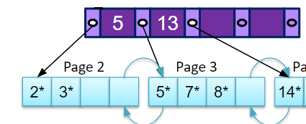
B+ trees
Inner nodes contain up to 2d values, and have a maximum fanout of 2d+1
These values do not have to correspond to actual search key values for records

Slide 9
B+ trees
Root Node
Page 1
17
To keep the fanout high (for performance guarantees), we have an occupancy invariant: every inner node (except the root) must be at least half full (at least d values)
Page 4
Page 6
5
13
24
30
Page 2
Page 3
Page 5
Page 7
Page 8
Page 9
2*
3*
5*
7*
8*
14*
16*
19*
20*
22*
24*
27*
29*
33*
34*
38*
39*
Notes:
Note: we don’t strictly follow the occupancy invariant in Project 2 (e.g. upon deletion, we don’t reorganize nodes if a node has < d values)

Slide 10
B+ trees
Root Node
Page 1
17
We may also add sibling pointers (pointers between leaf nodes)
Helps for scanning in sorted order
Page 4
Page 6
5
13
24
30
Page 2
Page 3
Page 5
Page 7
Page 8
Page 9
2*
3*
5*
7*
8*
14*
16*
19*
20*
22*
24*
27*
29*
33*
34*
38*
39*

Slide 11
Searching B+ trees

Slide 12
B+ trees: Search for 27
Find key = 27
Find split on each node
Follow pointer to next node
Root Node
17
5
13
24
30
2*
3*
5*
7*
8*
14*
16*
19*
20*
22*
24*
27*
29*
33*
34*
38*
39*

Slide 13
B+ trees: Search for 27
Find key = 27
Find split on each node
Follow pointer to next node
Use binary search on each page
Root Node
17
5
13
24
30
2*
3*
5*
7*
8*
14*
16*
19*
20*
22*
24*
27*
29*
33*
34*
38*
39*

Slide 14
B+ trees: Search for 27
Find key = 27
Find split on each node
Follow pointer to next node
Use binary search on each page
Root Node
17
5
13
24
30
2*
3*
5*
7*
8*
14*
16*
19*
20*
22*
24*
27*
29*
33*
34*
38*
39*

Slide 15
B+ trees: Search for 27
Find key = 27
Find split on each node
Follow pointer to next node
Use binary search on each page
Root Node
17
5
13
24
30
2*
3*
5*
7*
8*
14*
16*
19*
20*
22*
24*
27*
29*
33*
34*
38*
39*

Slide 16
B+ trees: Search for 27
Find key = 27
Find split on each node
Follow pointer to next node
Use binary search on each page
Root Node
17
5
13
24
30
2*
3*
5*
7*
8*
14*
16*
19*
20*
22*
24*
27*
27*
29*
33*
34*
38*
39*

Slide 17
Inserting into B+ trees

Slide 18
B+ trees: insert 25
Find the correct leaf node
Root Node
13
17
24
30
2*
3*
5*
7*
14*
16*
19*
20*
22*
24*
27*
29*
33*
34*
38*
39*

Slide 19
B+ trees: insert 25
Find the correct leaf node
Root Node
13
17
24
30
2*
3*
5*
7*
14*
16*
19*
20*
22*
24*
27*
29*
33*
34*
38*
39*

Slide 20
B+ trees: insert 25
Find the correct leaf node
If there is room in leaf, just add the entry
Root Node
13
17
24
30
2*
3*
5*
7*
14*
16*
19*
20*
22*
24*
27*
29*
33*
34*
38*
39*

Slide 21
B+ trees: insert 25
Root Node
13
17
24
30
2*
3*
5*
7*
14*
16*
19*
20*
22*
24*
27*
29*
33*
34*
38*
39*

Slide 22
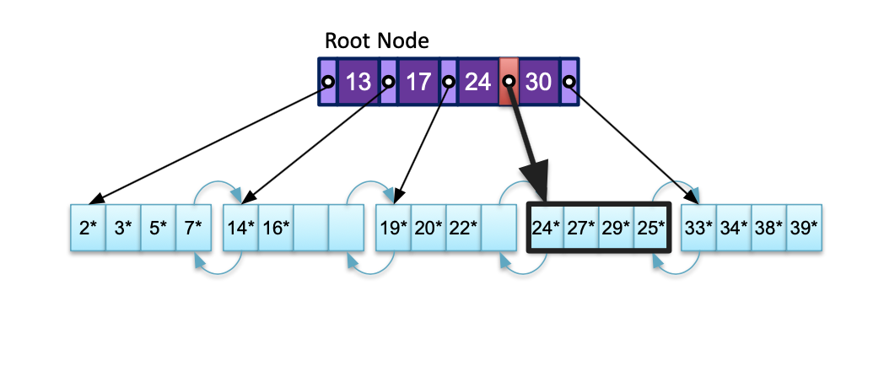
B+ trees: insert 25
Find the correct leaf node
If there is room in leaf, just add the entry

Slide 23
B+ trees: insert 25
Find the correct leaf node
If there is room in leaf, just add the entry
..and keep the leaf node sorted
Root Node
13
17
24
30
2*
3*
5*
7*
14*
16*
19*
20*
22*
24*
25*
27*
29*
33*
34*
38*
39*

Slide 24
B+ trees: insert 8
Root Node
8*
13
17
24
30
2*
3*
5*
7*
14*
16*
19*
20*
22*
24*
25*
27*
29*
33*
34*
38*
39*

Slide 25
B+ trees: insert 8
Find the correct leaf node
Root Node
8*
13
17
24
30
2*
3*
5*
7*
14*
16*
19*
20*
22*
24*
25*
27*
29*
33*
34*
38*
39*

Slide 26
B+ trees: insert 8
Find the correct leaf node
Root Node
8*
13
17
24
30
2*
3*
5*
7*
14*
16*
19*
20*
22*
24*
25*
27*
29*
33*
34*
38*
39*

Slide 27
B+ trees: insert 8
Find the correct leaf node
Split leaf if not enough room: into two leaves with d and d+1 entries
Root Node
13
17
24
30
2*
3*
14*
16*
19*
20*
22*
24*
25*
27*
29*
33*
34*
38*
39*
5*
7*
8*

Slide 28
B+ trees: insert 8
Find the correct leaf node
Split leaf if not enough room: into d and d+1 entries
Copy up the middle key to inner node (since leaf nodes have data)
13
17
24
30
Root Node
5
2*
3*
5*
7*
8*
14*
16*
19*
20*
22*
24*
25*
27*
29*
33*
34*
38*
39*

Slide 29
B+ trees: insert 8
If inner node is full, split the inner node into two and push the middle key up
Inner nodes don’t contain any data, so there’s no point copying the key
13
17
24
30
5
2*
3*
5*
7*
8*
14*
16*
19*
20*
22*
24*
25*
27*
29*
33*
34*
38*
39*

Slide 30
B+ trees: insert 8
If inner node is full, split the inner node into two and push the middle key up
Inner nodes don’t contain any data, so there’s no point copying the key
13
17
24
30
5
2*
3*
5*
7*
8*
14*
16*
19*
20*
22*
24*
25*
27*
29*
33*
34*
38*
39*

Slide 31
B+ trees: insert 8
If inner node is full, split the inner node into two and push the middle key up
Inner nodes don’t contain any data, so there’s no point copying the key
13
17
24
30
5
2*
3*
5*
7*
8*
14*
16*
19*
20*
22*
24*
25*
27*
29*
33*
34*
38*
39*

Slide 32
B+ trees: insert 8
If inner node is full, split the inner node into two and push the middle key up
Inner nodes don’t contain any data, so there’s no point copying the key
17
13
24
30
5
2*
3*
5*
7*
8*
14*
16*
19*
20*
22*
24*
25*
27*
29*
33*
34*
38*
39*
Notes:
The internal nodes can contain keys that don’t occur in any leaves

Slide 33
B+ trees: insert 8
If inner node is full, split the inner node into two and push the middle key up
Inner nodes don’t contain any data, so there’s no point copying the key
17
5
13
24
30
2*
3*
5*
7*
8*
14*
16*
19*
20*
22*
24*
25*
27*
29*
33*
34*
38*
39*

Slide 34
B+ trees: insertion
Find correct leaf L
Put data entry into L
If L has enough space, we’re done!
Otherwise, split L into two nodes: L and L₂
Copy up middle key to inner node and add references
If the inner node is full, split the inner node into two, and push up middle key; repeat as needed
Splits “grow” tree; splitting root increases height of tree
height = distance from root to leaf (0 if only one leaf)
Notes:
The internal nodes can contain keys that don’t occur in any leaves

Slide 35
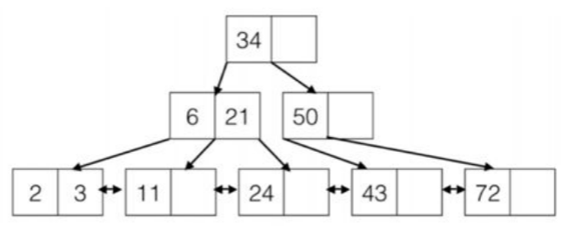
Worksheet #1a
What is the maximum number of insertions we can do without changing the height of the tree?

Slide 36
Worksheet #1a
What is the maximum number of insertions we can do without changing the height of the tree?
12. We could insert 12, 25, 44, 73, 74, 75, 76, 77, 78, 79, 80, 81.

Slide 37
Worksheet #1a
What is the maximum number of insertions we can do without changing the height of the tree?
More generally: assuming duplicates are allowed (or keys are not constrained to be integers), you can find the max number of keys a tree of the same height/order can store, and subtract the current number of keys

Slide 38
Worksheet #1a
Maximum number of data entries a B+ tree with height h can hold: (2d * (2d+1)^h)
each inner node for every level has a maximum fanout of (2d+1)
each inner node can contain a maximum of 2d data entries
(2 * d) * (2 * d+ 1)^{h} = (2 * 1) * (2 * 1 + 1)² = 18
18 (max) - 6 (number of values in tree given) = 12 inserts

Slide 39
Worksheet #1b
What is the minimum number of keys you could insert to change the height of the tree?

Slide 40
Worksheet #1b
What is the minimum number of keys you could insert to change the height of the tree?
3. You could insert 1, 4, 5.

Slide 41
Worksheet #1b
Insert 1
34
6
21
50
1
2
3
11
24
43
72

Slide 42
Worksheet #1b
Insert 1
34
6
21
50
1
2
3
11
24
43
72

Slide 43
Worksheet #1b
Insert 1
34
2
6
21
50
1
2
3
11
24
43
72

Slide 44
Worksheet #1b
Insert 1
34
2
6
21
50
1
2
3
11
24
43
72

Slide 45
Worksheet #1b
Insert 1
34
6
2
21
50
1
2
3
11
24
43
72

Slide 46
Worksheet #1b
Insert 1
6
34
2
21
50
1
2
3
11
24
43
72

Slide 47
Worksheet #1b
Insert 4
6
34
2
21
50
1
2
3
4
11
24
43
72

Slide 48
Worksheet #1b
Insert 4
6
34
2
21
50
1
2
3
4
11
24
43
72

Slide 49
Worksheet #1b
Insert 4
6
34
2
3
21
50
1
2
3
4
11
24
43
72

Slide 50
Worksheet #1b
Insert 5
6
34
2
3
21
50
1
2
3
4
5
11
24
43
72

Slide 51
Worksheet #1b
Insert 5
6
34
2
3
4
21
50
1
2
3
4
5
11
24
43
72

Slide 52
Worksheet #1b
Insert 5
6
34
2
3
4
21
50
1
2
3
4
5
11
24
43
72

Slide 53
Worksheet #1b
Insert 5
3
6
34
2
4
21
50
1
2
3
4
5
11
24
43
72

Slide 54
Worksheet #1b
Insert 5
6
3
34
2
4
21
50
1
2
3
4
5
11
24
43
72

Slide 55
Index types

Slide 56
How is data stored in the index?
Alternative 1: store actual records in the index
We can’t do this efficiently if we have multiple indices on the table (need to keep multiple copies)
Alternative 2: store <key, recordId> in the index
Alternative 3: store <key, list of matching RecordIDs>
More compact than Alternative 2 if we have a lot of duplicates
Notes:
Alternatives 2 and 3 are needed to support multiple indexes per table
Alternative 3 can be more compact than alternative 2

Slide 57
Alternative 1 Index (B+ Tree)
uid | name
2 | Joe
3 | Jim
5 | Kay
7 | Dan
20 | Tim
24 | Kit
Record contents are stored in the index file
No need to follow pointers
Root Node
17
Interior Nodes
5
24
Data Entries
(2, Joe)
(3, Jim)
(5, Kay)
(7, Dan)
(20, Tim)
(24, Kit)

Slide 58
Alternative 2 Index
uid | name
2 | Joe
3 | Jim
5 | Kay
7 | Dan
20 | Tim
24 | Kit
Alternative 2: By Reference, <k, rid of matching data record>
We used in slides above
Index File
Root Node
17
Interior Nodes
Index Contains
(Key, Record Id) Pairs
5
24
Data Entries
(2, [1,1])
(3, [1,2])
(5, [2,1])
(7, [2,2])
(20, [3,1])
(24, [3,2])
(2, Joe)
(3, Jim)
(5, Kay)
(7, Dan)
(20, Tim)
(24, Kit)

Slide 59
Alternative 3 Index
Alternative 3: By List of references, <k, list of rids of matching data records>
Alternative 3 more compact than alternative 2
For very large rid lists, single data entry spans multiple blocks
Index File
Root Node
Key | Record Id
2 | {[1,1], [1,2], [1,3]}
3 | 4
17
Index Contains
(Key, {list of record Id}) Pairs
Interior Nodes
5
24
Data Entries
(2, {[1,1], [1,2], [2, 1]}
(3, {[2,2], [3, 1]})
…
(20, {3, 2}])
…
(2, Joe)
(2, Jim)
(2, Kay)
(3, Dan)
(3, Tim)
(20, Kit)

Slide 60
Clustering
property of Alt 2, 3 Indexes
Clustered index: the actual data is (roughly) sorted in order of the search key
Can’t have two clustered indices on different columns without duplicating the data
Unclustered index: the actual data is not in order of the search key
Much less efficient

Slide 61
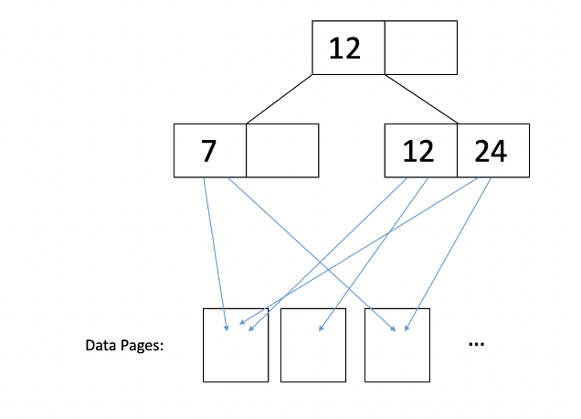
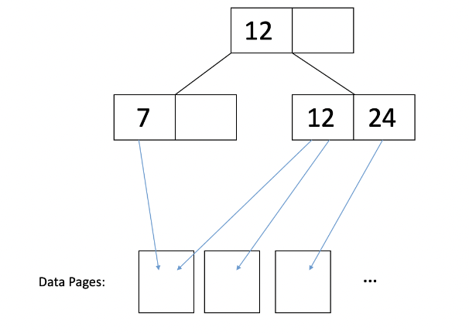
Clustering
Unclustered
Clustered
I/O Cost:
~ 1 I/O per record
~ 1 I/O per page of records

Slide 62
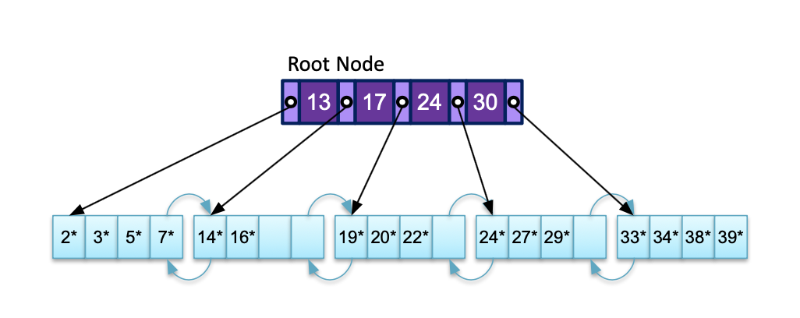
Note on Full Scans and B+ Trees
During full scans of B+ Trees, we DO NOT include the IO cost to traverse down the B+ tree and find the first data page
Cost to full scan = # of data pages
Ex. For this tree (assume alternative 1), full scan cost is 5 and NOT 1 + 5 = 6

Slide 63
Worksheet #2a
Is it possible to have two clustered indices on separate columns?

Slide 64
Worksheet #2a
Is it possible to have two clustered indices on separate columns?
Yes, but you would generally have to store two copies of the data (and keep both up to date).
Special case: if the search key for one index is a subset of the search key for the other (e.g. index 1 on sid, index 2 on (sid, name)), then we can have just one copy (sorted on (sid, name)).

Slide 65
Worksheet #2b
2. Suppose we have an alternative 2 unclustered index on (assignment_id, student_id) with a height of 3 (one must traverse 3 index pages to reach any leaf page). Here's the schema:
Assume the table takes up 12 MB on disk (1 MB = 1024 KB) and that page size is 64KB. (This includes extra space allocated for future insertions.)
We want to scan all the records in Submissions. How many I/Os will this operation take?
CREATE TABLE Submissions (
record_id integer UNIQUE,
assignment_id integer,
student_id integer,
time_submitted integer,
grade_received byte,
comment text,
regrade_request text,
PRIMARY KEY(assignment_id, student_id)
);
CREATE INDEX SubmissionLookupIndex
ON Submissions (assignment_id, student_id);

Slide 66
Worksheet #2b
2. Suppose we have an alternative 2 unclustered index on (assignment_id, student_id) with a height of 3 (one must traverse 3 index pages to reach any leaf page). Here's the schema:
Assume the table takes up 12 MB on disk (1 MB = 1024 KB) and that page size is 64KB. (This includes extra space allocated for future insertions.)
We want to scan all the records in Submissions. How many I/Os will this operation take?
CREATE TABLE Submissions (
record_id integer UNIQUE,
assignment_id integer,
student_id integer,
time_submitted integer,
grade_received byte,
comment text,
regrade_request text,
PRIMARY KEY(assignment_id, student_id)
);
CREATE INDEX SubmissionLookupIndex
ON Submissions (assignment_id, student_id);
To do a full table scan, we read each page into memory once. There are 12 * 1024/64 = 192 pages in the table, so that’s 192 I/Os (all page reads).

Slide 67
Worksheet #2c
2. Suppose we have an alternative 2 unclustered index on (assignment_id, student_id) with a height of 3 (one must traverse 3 index pages to reach any leaf page). Here's the schema:
Assume the table takes up 12 MB on disk (1 MB = 1024 KB) and that page size is 64KB. (This includes extra space allocated for future insertions.)
UPDATE Students SET grade_received=85 WHERE assignment_id=20 AND student_id=12345; How many I/Os will this operation take?
CREATE TABLE Submissions (
record_id integer UNIQUE,
assignment_id integer,
student_id integer,
time_submitted integer,
grade_received byte,
comment text,
regrade_request text,
PRIMARY KEY(assignment_id, student_id)
);
CREATE INDEX SubmissionLookupIndex
ON Submissions (assignment_id, student_id);

Slide 68
Worksheet #2c
Assume the table takes up 12 MB on disk (1 MB = 1024 KB) and that page size is 64KB. (This includes extra space allocated for future insertions.)
UPDATE Students SET grade_received=85 WHERE assignment_id=20 AND student_id=12345; How many I/Os will this operation take?
Read the page into memory: 3 page reads for the index + 1 page read for the leaf page
+ 1 page read for the data page (b/c alt. 2)
Write the modification in memory and then flush the page back to disk: 1 page write for the data page
This costs us a total of 6 disk I/Os.
2. Suppose we have an alternative 2 unclustered index on (assignment_id, student_id) with a height of 3 (one must traverse 3 index pages to reach any leaf page). Here's the schema:
CREATE TABLE Submissions (
record_id integer UNIQUE,
assignment_id integer,
student_id integer,
time_submitted integer,
grade_received byte,
comment text,
regrade_request text,
PRIMARY KEY(assignment_id, student_id)
);
CREATE INDEX SubmissionLookupIndex
ON Submissions (assignment_id, student_id);
Notes:
Step 2: since we already knew where the page was, we can immediately do the write without the corresponding lookup

Slide 69
Worksheet #2d
2. Suppose we have an alternative 2 unclustered index on (assignment_id, student_id) with a height of 3 (one must traverse 3 index pages to reach any leaf page). Here's the schema:
Assume the table takes up 12 MB on disk (1 MB = 1024 KB) and that page size is 64KB. (This includes extra space allocated for future insertions.)
In the worst case, how many I/Os does it take to perform an equality search on grade_received?
CREATE TABLE Submissions (
record_id integer UNIQUE,
assignment_id integer,
student_id integer,
time_submitted integer,
grade_received byte,
comment text,
regrade_request text,
PRIMARY KEY(assignment_id, student_id)
);
CREATE INDEX SubmissionLookupIndex
ON Submissions (assignment_id, student_id);

Slide 70
Worksheet #2d
2. Suppose we have an alternative 2 unclustered index on (assignment_id, student_id) with a height of 3 (one must traverse 3 index pages to reach any leaf page). Here's the schema:
Assume the table takes up 12 MB on disk (1 MB = 1024 KB) and that page size is 64KB. (This includes extra space allocated for future insertions.)
In the worst case, how many I/Os does it take to perform an equality search on grade_received?
In the worst case, any record can match the grade_received predicate. Therefore, we must check every record of the table. This is equivalent to performing a table scan, and we would read every page, requiring 192 page reads.
CREATE TABLE Submissions (
record_id integer UNIQUE,
assignment_id integer,
student_id integer,
time_submitted integer,
grade_received byte,
comment text,
regrade_request text,
PRIMARY KEY(assignment_id, student_id)
);
CREATE INDEX SubmissionLookupIndex
ON Submissions (assignment_id, student_id);
Notes:
Also, here the best case is identical to the worst! Because there are no restrictions on how many times a single grade_received value shows up, we must always read every record to complete this query correctly.

Slide 71
Bulkloading

Slide 72
Bulkloading Procedure
Creating a B+ tree from scratch is very costly if we insert every node because we have to traverse from the top of the tree to the bottom each time. Instead, use bulkloading:
Sort the data pages by the given key
Given a fill factor f, fill leaves with the data until the fill factor. If the leaf node overflows, add the overflowing value to the parent node + start filling in a new leaf
If the parent node overflows, split the parent node into two groups:
Keep d entries to L₁ and d + 1 entries to L₂
Move the first entry in L₂ to parent since the parent overflowed
Adjust pointers

Slide 73
Worksheet #3
Suppose we were to create an order d=2 B+ tree via bulk-loading with a fill factor of 3/4. We insert keys with all integer values from 1-16 in order.
Here, fill factor specifies the fill factor for leaves only; inner nodes should be filled up to full and split in half exactly.
Draw out the final B+ tree. What is its height?

Slide 74
Bulk Loading: d = 2, f = 3/4 * GREY indicates an INTERMEDIATE step, which is not a valid state
Inserting 1-16 in order into an empty B+ tree
1

Slide 75
Bulk Loading: d = 2, f = 3/4 * GREY indicates an INTERMEDIATE step, which is not a valid state
1
2

Slide 76
Bulk Loading: d = 2, f = 3/4 * GREY indicates an INTERMEDIATE step, which is not a valid state
1
2
3

Slide 77
Bulk Loading: d = 2, f = 3/4 * GREY indicates an INTERMEDIATE step, which is not a valid state
Leaf node has exceeded fill factor of 3/4 (since there are more than 3 entries)
1
2
3
4

Slide 78
Bulk Loading: d = 2, f = 3/4 * GREY indicates an INTERMEDIATE step, which is not a valid state
Split leaf node
4
1
2
3
4

Slide 79
Bulk Loading: d = 2, f = 3/4 * GREY indicates an INTERMEDIATE step, which is not a valid state
4
1
2
3
4
5

Slide 80
Bulk Loading: d = 2, f = 3/4 * GREY indicates an INTERMEDIATE step, which is not a valid state
4
1
2
3
4
5
6

Slide 81
Bulk Loading: d = 2, f = 3/4 * GREY indicates an INTERMEDIATE step, which is not a valid state
Leaf node has exceeded fill factor of 3/4 (since there are more than 3 entries)
4
1
2
3
4
5
6
7

Slide 82
Bulk Loading: d = 2, f = 3/4 * GREY indicates an INTERMEDIATE step, which is not a valid state
Split leaf node
4
7
1
2
3
4
5
6
7

Slide 83
Bulk Loading: d = 2, f = 3/4 * GREY indicates an INTERMEDIATE step, which is not a valid state
4
7
1
2
3
4
5
6
7
8

Slide 84
Bulk Loading: d = 2, f = 3/4 * GREY indicates an INTERMEDIATE step, which is not a valid state
4
7
1
2
3
4
5
6
7
8
9

Slide 85
Bulk Loading: d = 2, f = 3/4 * GREY indicates an INTERMEDIATE step, which is not a valid state
Leaf node has exceeded fill factor of 3/4 (since there are more than 3 entries)
4
7
1
2
3
4
5
6
7
8
9
10

Slide 86
Bulk Loading: d = 2, f = 3/4 * GREY indicates an INTERMEDIATE step, which is not a valid state
Split leaf node
4
7
10
1
2
3
10
4
5
6
7
8
9

Slide 87
Bulk Loading: d = 2, f = 3/4 * GREY indicates an INTERMEDIATE step, which is not a valid state
4
7
10
1
2
3
10
11
4
5
6
7
8
9

Slide 88
Bulk Loading: d = 2, f = 3/4 * GREY indicates an INTERMEDIATE step, which is not a valid state
4
7
10
1
2
3
10
11
12
4
5
6
7
8
9

Slide 89
Bulk Loading: d = 2, f = 3/4 * GREY indicates an INTERMEDIATE step, which is not a valid state
Leaf node has exceeded fill factor of 3/4 (since there are more than 3 entries)
4
7
10
1
2
3
10
11
12
13
4
5
6
7
8
9

Slide 90
Bulk Loading: d = 2, f = 3/4 * GREY indicates an INTERMEDIATE step, which is not a valid state
Split leaf node
4
7
10
13
1
2
3
13
4
5
6
7
8
9
10
11
12

Slide 91
Bulk Loading: d = 2, f = 3/4 * GREY indicates an INTERMEDIATE step, which is not a valid state
4
7
10
13
1
2
3
13
14
4
5
6
7
8
9
10
11
12

Slide 92
Bulk Loading: d = 2, f = 3/4 * GREY indicates an INTERMEDIATE step, which is not a valid state
4
7
10
13
1
2
3
13
14
15
4
5
6
7
8
9
10
11
12

Slide 93
Bulk Loading: d = 2, f = 3/4 * GREY indicates an INTERMEDIATE step, which is not a valid state
Leaf node has exceeded fill factor of 3/4 (since there are more than 3 entries)
4
7
10
13
1
2
3
13
14
15
16
4
5
6
7
8
9
10
11
12

Slide 94
Bulk Loading: d = 2, f = 3/4 * GREY indicates an INTERMEDIATE step, which is not a valid state
Split leaf node
Parent node is full (since there are more than 4 entries)
4
7
10
13
16
1
2
3
13
14
15
16
4
5
6
7
8
9
10
11
12

Slide 95
Bulk Loading: d = 2, f = 3/4 * GREY indicates an INTERMEDIATE step, which is not a valid state
Split parent node into 2 nodes with d = 2 entries each
4
7
10
13
16
1
2
3
13
14
15
16
4
5
6
7
8
9
10
11
12

Slide 96
Bulk Loading: d = 2, f = 3/4 * GREY indicates an INTERMEDIATE step, which is not a valid state
Split parent node into 2 nodes with d = 2 entries each
10
4
7
13
16
1
2
3
13
14
15
16
4
5
6
7
8
9
10
11
12

Slide 97
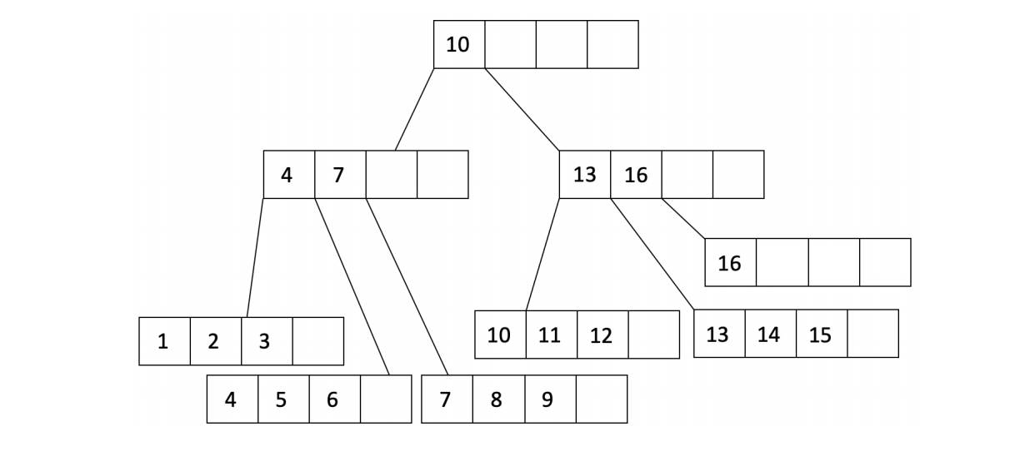
Worksheet #3
The final height of the tree would be 2.

Slide 98
Summary
Inner nodes contain up to 2d values, and have a maximum fanout of 2d+1
Maximum number of data entries a B+ tree with height h can hold: (2d * (2d+1)^h)
B+ tree insertion:
Find correct leaf node L and insert into L if there is space
if L is full:
split L into L1 and L2
if L is a leaf node, copy up middle key to inner node
if L is an inner node, push up middle key
B+ tree indices
Alternative 1: Record contents are stored in the index file
Alternative 2: By Reference, <k, rid of matching data record>
Alternative 3: By List of references, <k, list of rids of matching data records>

Slide 99

Attendance Link
https://cs186berkeley.net/attendance

